Slide 1
Iddo/Ivan/Iscott’s Microarray Data Examination
Meta+Host
Data Harmonization
Project

Slide 2
Codelink Array Design & QC
29 samples (10 FF, 7 BF, 6 BMS, 6 Premie)
Probes 54359 (963 are fiducial & +/- controls)
Removed Error flagged measurements (M/C/I/P):
Sample | FF | BF | Premie | Replicates
1 | 1359 (2.5%) | 1303 (2.4%) | 1046 (2.0%) | *1239 (2.3%)
2 | 1276 (2.4%) | 1326 (2.5%) | 949 (1.8%) | 1287 (2.4%)
3 (FF) (BF) | *1342 (2.5%) | *1210 (2.3%) | 1022 (1.9%) | *1241 (2.3%)
4 (FF) | *1219 (2.3%) | 1239 (2.3%) | 1097 (2.1%) | *1127 (2.1%)
5 (FF) (BF) | *1183 (2.2%) | *1140 (2.1%) | 944 (1.9%) | *1377 (2.6%)
6 (FF) | *1198 (2.2%) | 1155 (2.2%) | 1030 (1.9%)
7 | 1178 (2.2%) | 1642 (3.1%)
8 (FF) (BF) | *1146 (2.1%) | *1255 (2.3%)
9 | 1173 (2.2%) | 1240 (2.3%)
10 (FF) (BF) | *1019 (1.9%) | *1355 (2.5%)
11 (BF) |  | *1311 (2.5%)
12 |  | 1244 (2.3%)
13 (BF) |  | *1219 (2.3%) | *Also have metagemome sequencing samples

Slide 3
Codelink Array “Low” flags
“Low” flag: Signal mean < Bkgd_median + 1.5*Bkgd_stdev
More “Low” flags in FF compared to BF

Slide 4
Further breakdown of “Low” flags
Sample | FF | BF | Premie
1 | 41255 (77.2%) | 24601 (46%) | 35638 (66.7%)
2 | 41784 (78.2%) | 36081 (67.5%) | 41019 (76.8%)
3 (FF) (BF) | *41267 (77.2%) | *34790 (65.1%) | 42721 (80.0%)
4 (FF) | *40723 (76.2%) | 35191 (65.9%) | 43776 (81.9%)
5 (FF) (BF) | *38567 (72.2%) | *33293 (62.3%) | 42205 (79.0%)
6 (FF) | *39486 (73.9%) | 34945 (65.4%) | 42903 (80.3%)
7 | 39158 (73.3%) | 28535 (53.4%)
8 (FF) (BF) | *31946 (59.8%) | *36120 (67.6%)
9 | 36640 (68.6%) | 37445 (70.1%)
10 (FF) (BF) | *39399 (73.7%) | *34665 (64.9%)
11 (BF) |  | *29010 (54.3%)
12 |  | 34033 (63.7%)
13 (BF) |  | *34747 (65.0%)
*Also have metagemome sequencing samples

Slide 5
Expression values distributions
Data is shifted so all values are positive, then log2’d
Codelink Normed Val = Raw/median(Raw)… just line this up at 0
More “Low” flags in FF because FF have lower distributions. duh.

Slide 6
Raw Data without “Low” flags
The general shift difference between FF and BF naturally remains even after “low” flagged genes are removed
Losing data: ~75% FF, ~65% BF, and ~78% premie

Slide 7
Background noise on slides
Raw Intensity is actually Spot_mean - Bkgr_median
Spot_mean - Bkgr_median is a global shift normalization
Background noise doesn’t have the same FF/BF shift pattern

Slide 8
Replication
Replication means we might say strange results are genuine
Higher expressions are more replicable
The shift difference between FF and BF may be real
(4 of the 5 replicates have been metagenome sequenced)

Slide 9
Sanity Check
Replicates versus wrong samples
Yeah! …when looking like crap is a chance to celebrate!

Slide 10
What does the MA plot look like
BF babies genes tend to be higher expressing than FF, still
Usually, a picture like this results in a loess normalization…
Regardless, there’s a group of exceptionally up expressed genes
No obviously down expressed genes… ?

Slide 11
Gene expression in BF babies seems highly variable

Slide 12
Gene expression in BF babies seems highly variable

Slide 13
Conclusions (input welcome)
Higher measurements are more replicable
Genes are more highly expressed in BF than FF
Subset of genes strongly driven by BF: Gene activity depends on BF environment
Try several data sets
No normalization
Loess normalization
Chen’s normalization

Slide 14
Other notes
We’re prototyping… data analysis is fallible
Sample T00346118_FF5_1.TXT being the same as T00346112_FF4_2.TXT
Not sure about doing outlier detection?
Need to do one data processing QC step to make sure outlier BF patters are really there

Slide 15
Single gene prediction via phylum composition and future steps
Meta+Host transcriptome
Data Harmonization
Project

Slide 16
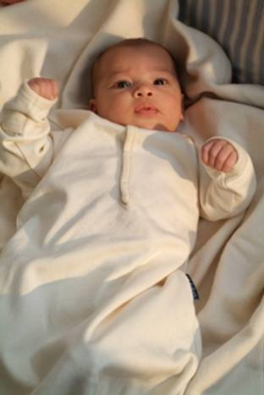
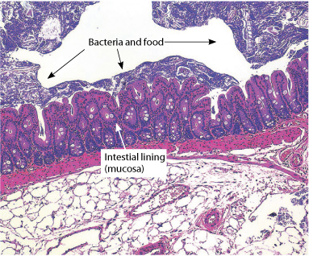
Big Picture
FF/BF Babies – Noninvasive Examination – Metagenome Sequencing – Host Microarray

Slide 17
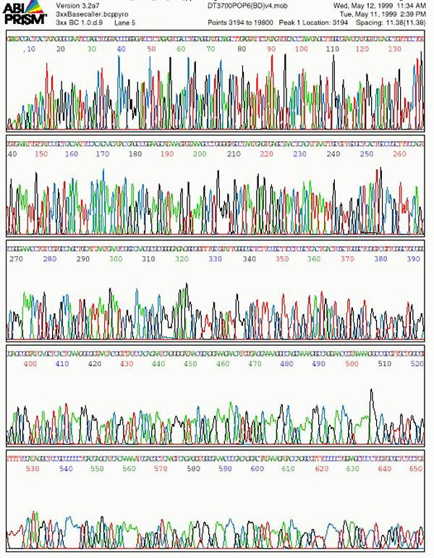
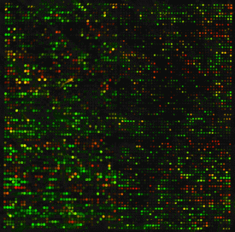
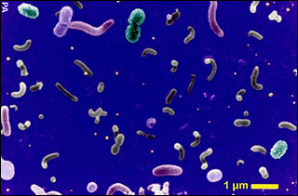
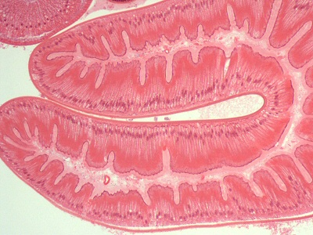
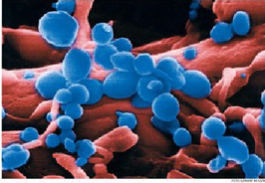
Combine this info!! Get something useful!?

Slide 18
What we’ve got
12 fecal samples (6BF/6FF)
Microarray of eukaryotic mRNA
454 Shotgun/16S sequencing of metagenome
Big question: Relate bacterial functional pathways to host functional pathways via array/sequence mRNA data
Little question: Relate bacterial phylum distribution to single gene expression

Slide 19
Too broad? High level Phylum data
Phylum makeup classifies FF/BF (top/bottom)
GE versus FF/BF signatures is just DE analysis

Slide 20

Too narrow? Fine level Phylum data
Subtle differences in phylum sample makeup ARE NOT predictive of fine levels of gene expression differences between samples.
E.g.: FF samples 5 and 6 have similar Phylum breakdowns:
For gene X, sample 5 has a similar, slightly higher, expression measure then sample 6...
We WON’T attempt to explain this by Phylum
Gene Expression
5
6
. X(5)
. X(6)

Slide 21
In perspective? Predict coarse scale GE via Phylum distribution
Coarse differences in samples phylum makeup ARE predictive of coarse differences in gene expressions between samples.
E.g.: Samples FF 6 and BF 3 have distinct Phylum makeups:
For gene X, the two samples have recognizably distinct expression levels...
We WILL attempt to explain this by Phylum
Gene Expression
FF
BF
. X(FF)
. X(BF)

Slide 22
Phylum signatures
5 distinct signatures: 6FF, 3BF, BF’, BF’’, BF’’’
Signatures are “coarse” phylum measures

Slide 23
Baby question strategy
Coarse phylum signature should be predictive of gross scale gene expression measurements
Gene Expression
. X(1)
. X(2)
Predict

Slide 24
Most informative phylum
Two strongest identifying characteristics:
firmicutes: distinguishes FF/BF
Actinobacteria: distinguishes BF/BF’ samples

Slide 25
First try prediction methodology
Firmicutes (F) and Actinobacteria (A) strongly informative phylum signature
Linear model prediction: single gene expression by F, A, and BF/FF

Slide 26
Preliminary Results
Raw data only – no further processing
Used 16853 genes that had less than a majority of “low” flags in either FF or BF
394 genes were usefully predicted by
firmicutes, Actinobacteria, BF versus FF

Slide 27
Linear Model: firmicutes, Actinobacteria, BF Indicator
1st order – plane with shift for BF babies
Left R^2=.88; Right R^2=.62

Slide 28
Quantitatively relating (single) gene expression to Phylum distribution
GE(X) = B_0 + F*B_f + A*B_a + (BF)*B_(bf)
F: FF babies have higher %, so they’ll be more changed (+/-) more by Beta_f
A: FF babies have average %, BF signature babies have high %, and BF’ signature babies have low %: Strength of effect (+/-) will be analogous
BF babies have higher expression levels…

Slide 29
Notes
Using %firmicutes and %Actinobacteria as continuous predictors utilizes more phylum distribution information than, e.g., firmicutes = {high/low}, Actinobacteria = {high/med./low}
Phylum signatures are a simplex (n=6) – not all can be used as predictors – we used strongest
4 parameters and 12 data points leave 8 df
Does not blatantly overfit the data (e.g., like using the 5 distinct signatures as categories)

Slide 30
Ideas for future Analyses
Meta+Host transcriptome
Data Harmonization
Project

Slide 31
Big Picture
FF/BF Babies – Noninvasive – Metagenome Sequencing – Host Microarray

Slide 32
Available data
12 fecal samples (6BF/6FF)
Microarray of Host eukaryotic mRNA
H(a): Univariate (single) gene expression data
H(b): Multivariate (group) gene expression data
H(c) (Subset of) functional composition data [?]
454 Shotgun/16S sequencing of Metagenome
M(a): (Subset of) phylum composition
M(b): (Subset of) functional composition data

Slide 33
Combine this info!! Get something useful!?

Slide 34
Possible analyses
(1) Relate bacterial functional pathways to host functional pathways
(2) Use bacterial information + host information to classify FF/BF
(3) Relate bacterial functional pathways to subset of host gene expression
(4) Relate bacterial phylum distribution to subset of host gene expression

Slide 35
(1) Functional Analysis
Can we quantitatively relate Bacterial and Host functionally activated pathways?
GO
ontology
*
?
Array

Slide 36

(1) Functional Analysis
Correlate functional categories: covariance, Bayes, mutual information, or CoD methods
metagenome
host
darker: stronger association

Slide 37
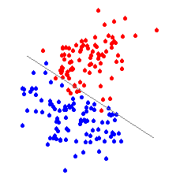
(2) BF/FF classification
Use both metagenome and host information in BF/FF classification, e.g., using LDA
BF
FF

Slide 38
(2) BF/FF classification
E.g., phylum distinguishes FF/BF
Right: FF(blue); BF(green/brown)
Below: FF (top); BF (bottom)

Slide 39
(3) Multivariate analysis
The analytical concept here is analogous to that of (1), the functional analysis.
we relate the high dimensional variable of, e.g., distribution of metagenome functional pathways to a set of gene expression values.
Another method for relating multivariate variables to multivariate variables is canonical correlation analysis.

Slide 40
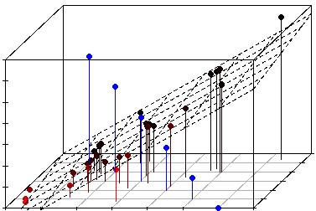
(4) Univariate prediction
Predict univariate gene expression using phylum/function metagenome characteristics
BF
FF

Slide 41
(4) Univariate prediction
Phylum composition % predicts expression. Nonlinear MI and CoD methods available.
Gene Expression
FF
. X(BF)
Predict
. X(FF)
BF
Gradient is surface of prediction
Circle size is gene expression

Slide 42
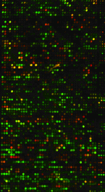
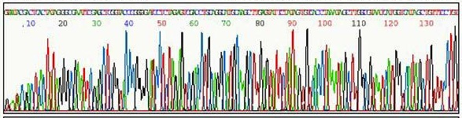

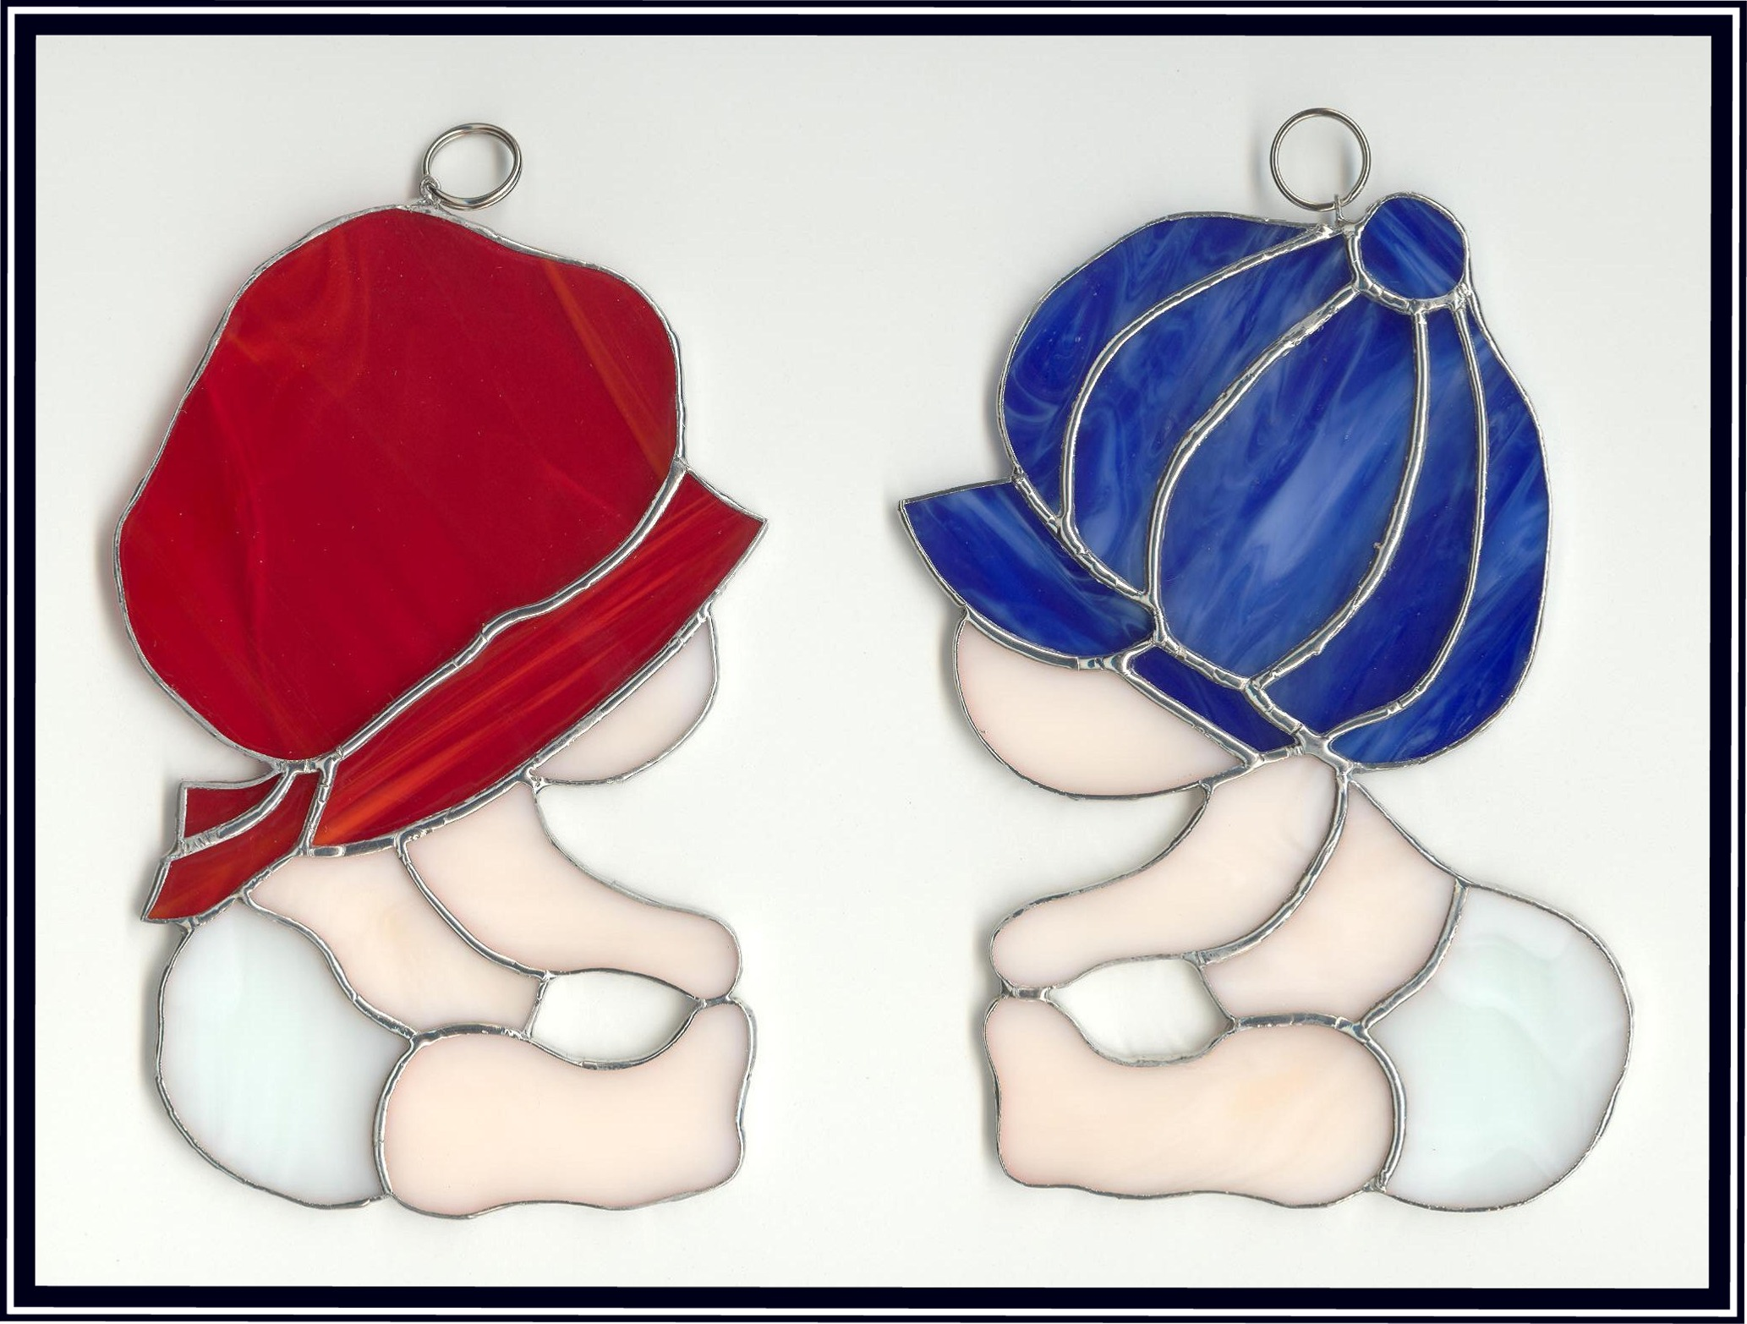
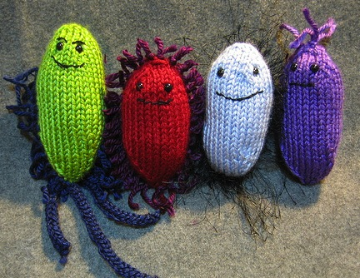
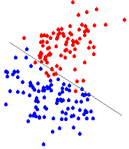
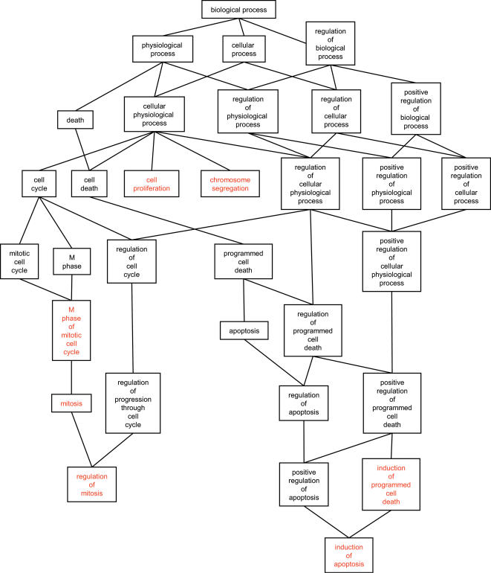
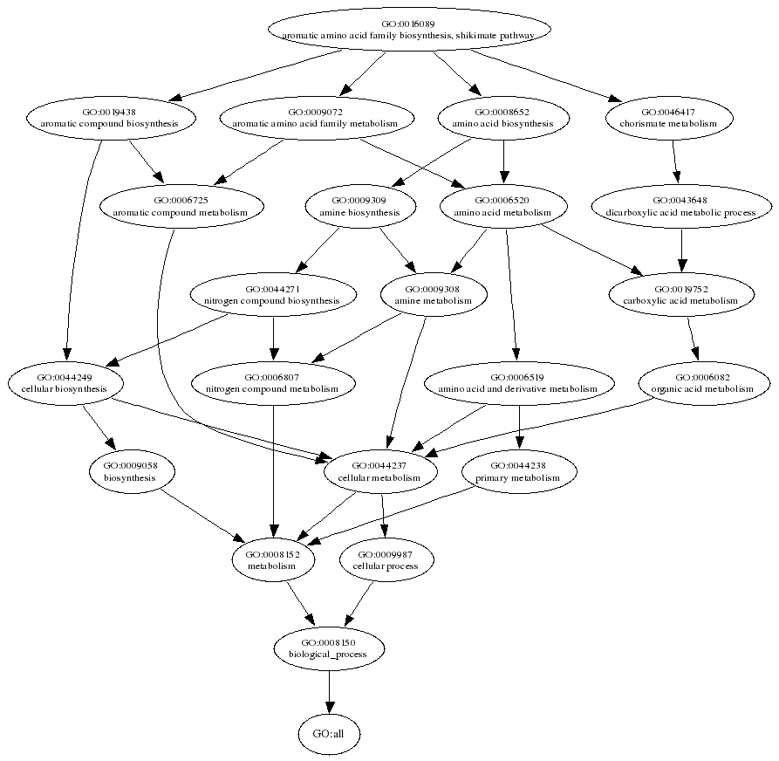
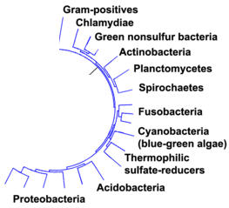
Summary
Microarray
Sequencing
Prediction
Classification
Covariance Analysis
Functional
pathways
Functional
pathways (?)
Phylum makeup

Slide 43
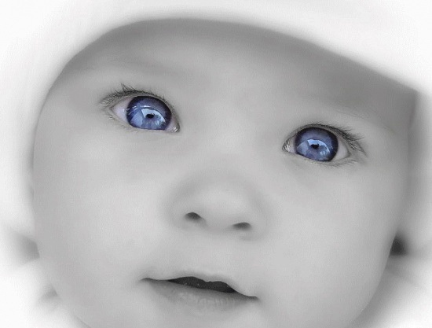
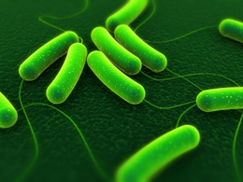
Data Harmonization
Microarray
Sequencing
Prediction
Classification
Covariance Analysis
Functional
pathways
Functional
pathways (?)
Phylum makeup

Slide 44
Roadmap
Try various normalization for analysis (4)
Repeat analysis (4) using microbiome metabolic pathways in place of phylum %’s
Begin to examine analysis (2) en route
Examine potential roles for PCA analysis en route
Begin analysis (3) by examining pairwise correlation structure between microbiome pathways and host mRNA expression

Slide 45
Normalized microarray
These are the two data sets we’re using. The loess normalization is artificially shifted up

Slide 46
Normalized microarray
FF is kept higher by personal preference: the loess line (blue) is arbitrary shifted up from 0

Slide 47
Model Fitting Results which ones had the small qvalue
No significance w/ multiple testing correction. But there are still some suggestions of findings

Slide 48
Model interpretation
Fits relationships between expression and %F./A. that are internally consistent across FF/BF

Slide 49
Questions/Comments
From lab meeting:
(a) Phylum is too coarse to be predictive
(b) Does the interpretation of the model coefficients make sense? What does it mean?
Thoughts:
(a) Yes, phylum is probably to coarse
(b) Alternative specifications address different hypothesis about the data relationships

Slide 50
Need to get to functional stuff
maximum e-value 10^-5
minimum alignment length of 100.
Three min % identity thresholds: 80, 70 & 60.

Slide 51
Metabolic Profile: SEED level 1
Lots of small slivers… everybody gets some pie

Slide 52
What are the metabolic profiles? Pool samples
Don’t appear to be obvious FF/BF differences

Slide 53
Dimension Reduction #1
For PCA, we have 12 samples, so we’ll use 10

Slide 54
Singular Value Decomposition (SVD): Dimensionality Reduction
X=UDV’ : ([nXp] = [nXl][lXr][rXp])
U’ is a change of basis for X – puts axis structure along the spatial directions of greatest variation
This provides dimensionality reduction since the new basis induced by U’ may be of smaller dimension (l<p) than the original basis.
Proportion of ``variation’’ explained in by the ith dimension of the new basis is proportional to Sqrt(D(i))= ith EigenValue(XX’)
Derivation notes: U and V are orthogonal, i.e., UU’=U’U=I, so, U’X=DV’ and XX’=WDD’W’

Slide 55
Principal Components [R PCA object plot… biplot]
Used p=10 most common (on average) metabolic functions and did a SVD

Slide 56
Classification with SVD PCs [plot 1st versus 2nd ]
There’s probably something there in the 2nd and 4th principal components

Slide 57
What are these PCs anyway? [biplot]
1stPC:
Nuclo’s/Cofactors…/
DNA-Protein Metab./
AAs/Cluster subsystems/
Virul/Carbs
2ndPC:
Carb/Virul/
Cell Wall
4thPC:
RNA Metab./
Cell Wall

Slide 58
Dimension Reduction #2
2nd and 4th PCs were respectively driven by:
`Carbohydrates’ and `Virulence’, and
`Cell Wall and Capsule’ and `RNA Metabolism’

Slide 59
SEED level 2
Carbohydrate metabolic profile

Slide 60
SEED level 2
Again, not much classification power

Slide 61
Host Annotation
CodeLink provided some annotation

Slide 62
Go Hierarchy
DAG directional (multiple parents)
DAVID terminal nodes

Slide 63
BP00148:Immunity and defense
71.5% (4974) of OGS annotated genes were present in Panther Biological Processes
Of those, 7.5% (519) were categorized as BP00148:Immunity and defense
517 (? case issues?) were found back on codelink, in 630 total probes
This subset of probes was taken forward to the next step of processing

Slide 64
Panther Molecular Function
Probes can be assigned Molecular Functions

Slide 65
BP00148:Immunity and defense [.2 q-value cutoff]
There are a handful of interesting Immunological genes relative to FF/BF
Circled points are smallest 10 p-values

Slide 66
Correlation Structure
Top 10 microbiome functional categories versus 10 most prominent host immune genes

Slide 67
interproscan
Send Iddo list of 16k genes
He’ll get better annotation on the probes
Super fancy annotations
Unifrac (google) = standard discrimination analysis … for visualization
I need to subscribe to use that tool
Send future directions to iddo
[interproscan – gene list = pfam, protein blast, GO’s, … interprostats: get Iddo the ]

Slide 68
interproscan
Send Iddo list of 16k genes
He’ll get better annotation on the probes
Super fancy annotations
Unifrac (google) = standard discrimination analysis … for visualization
I need to subscribe to use that tool
Send future directions to iddo

Slide 69
Principal Components
Iddo, are we getting good amount of mapping? Iddo, different data bases are different… should we be concerned?
GO/KEGG/David/Ensemble … start looking at correlation structure… Manasvi/Jennifer
Abstract Feb 10 (under 2 weeks)
DeNovo searching versus positive control
Keep flow diagrams – restrict to immunology
DoBy

Slide 70
Principal Components
DoBy
X^2 Homogeneity test w/in treatment
Loess/bayes nonparametric curve estimation (On just bacterial side… phylum or metabolic profile)… is dirichlet sample interesting.

Slide 71
Work Flow --
Here’s the plan…
LDA classification BF/FF:
Phylum %
Raw Data
pipeline
Linear Model Prediction:
Single gene EV vs. Phylum %
Microbiome data preparation
PCA (SVD) Functional %
Host data preparation:
Key Host Measures (EV/G0?)
LDA classification BF/FF:
PCA selected Functional %
Covariation Analysis:
Key Microbiome vs. Key Host
Nonlinear methods:
Classify/Predict/Correlate

Slide 72
Normalized microarray
FF is kept higher by personal preference: the loess line (blue) is arbitrary shifted up from 0

Slide 73
Normalized microarray
These are the two data sets we’re using. The loess normalization is artificially shifted up

Slide 74
Premie Babies
Premie babies have very low measurements everywhere…

Slide 75
Premie versus Normalized microarray
The general trend is the same

Slide 76
Removed this from the san fran pres
Took this out of our other analysis

Slide 77
SEED 3 Metabolic functions
Tested CURVES with a permutation test:
Clustering-based subsystems - Translation (BF/FF curve p=0.0047)
*Carbohydrates -CO2 fixation (BF/FF curve p=0.0086)
Cofactors, Vitamins, Prosthetic Groups, Pigments - NAD and NADP (BF/FF curve p=0.0091)
Miscellaneous - Miscellaneous (BF/FF curve p=0.0106)
*Respiration - Respiration (BF/FF curve p=0.0131)
Carbohydrates - Monosaccharides (BF/FF curve p=0.0133)
*Respiration - Electron donating reactions (BF/FF curve p=0.0198)
Virulence - Resistance to antibiotics and toxic compounds
(BF/FF curve p=0.088)
*tiny number of fragments assigned

Slide 78
SEED 3 Metabolic functions
 | perm.p | all.n
Virulence - Resistance to antibiotics and toxic compounds - Beta-lactamase | 0.0019 | 144
Carbohydrates - Monosaccharides - L-Arabinose_utilization | 0.002 | 2438
Carbohydrates - Monosaccharides - L-fucose_utilization | 0.0038 | 512
Carbohydrates - Organic acids - Lactate_utilization | 0.0041 | 404
Clustering-based subsystems - Translation - CBSS-326442.4.peg.1852 | 0.0041 | 1168
Virulence - Prophage, Transposon - IbrA_and_IbrB:_co-activators_of_prophage_gene_expression | 0.0043 | 112
DNA Metabolism - DNA Metabolism - YcfH | 0.0045 | 232
Clustering-based subsystems - Translation - CBSS-243265.1.peg.198 | 0.0045 | 213
Cofactors, Vitamins, Prosthetic Groups, Pigments - NAD and NADP - NAD_and_NADP_cofactor_biosynthesis_global | 0.0047 | 2447
Cell Wall and Capsule - Gram-Negative cell wall components - Outer_membrane | 0.0058 | 118
Clustering-based subsystems - Clustering-based subsystems - CBSS-251221.1.peg.1863 | 0.006 | 329
Clustering-based subsystems - Clustering-based subsystems - CBSS-316273.3.peg.227 | 0.0064 | 947
Respiration - Electron donating reactions - Respiratory_Complex_I | 0.0077 | 976
Carbohydrates - CO2 fixation - Calvin-Benson_cycle | 0.0087 | 130
Amino Acids and Derivatives - Arginine; urea cycle, polyamines - Arginine_Biosynthesis_extended | 0.0088 | 440
Carbohydrates - CO2 fixation - Photorespiration_(oxidative_C2_cycle) | 0.0098 | 147
Miscellaneous - Miscellaneous - Biolumenescence | 0.0107 | 146
Miscellaneous - Miscellaneous - Transporters_In_Models | 0.0109 | 13286
Cell Wall and Capsule - Gram-Negative cell wall components - Perosamine_Synthesis_Vibrio | 0.0113 | 102
Clustering-based subsystems - Clustering-based subsystems - CBSS-345072.3.peg.1318 | 0.0136 | 117
DNA Metabolism - DNA replication - DNA_topoisomerases,_Type_I,_ATP-independent | 0.0142 | 105
Cell Wall and Capsule - Capsular and extracellular polysacchrides - CMP-N-acetylneuraminate_Biosynthesis | 0.0181 | 60
Carbohydrates - Central carbohydrate metabolism - Dehydrogenase_complexes | 0.0221 | 848
Respiration - Respiration - Formate_hydrogenase | 0.0223 | 1225
Sulfur Metabolism - Inorganic sulfur assimilation - Sulfate_assimilation | 0.023 | 114
Virulence - Type III, Type IV, ESAT secretion systems - Type_IV_pilus | 0.0232 | 215
Cofactors, Vitamins, Prosthetic Groups, Pigments - NAD and NADP - NAD_regulation | 0.0303 | 316
Carbohydrates - Central carbohydrate metabolism - Embden-Meyerhof_and_Gluconeogenesis_Archaeal | 0.0317 | 807
Clustering-based subsystems - Clustering-based subsystems - CBSS-228410.1.peg.134 | 0.0327 | 359
Respiration - Electron donating reactions - Respiratory_dehydrogenases_1 | 0.0355 | 815
Clustering-based subsystems - Clustering-based subsystems - CBSS-56780.10.peg.1536 | 0.036 | 650
Clustering-based subsystems - Clustering-based subsystems - CBSS-296591.1.peg.2330 | 0.0365 | 202
Carbohydrates - Monosaccharides - L-rhamnose_utilization | 0.0403 | 695
Respiration - Electron accepting reactions - Anaerobic_respiratory_reductases | 0.0419 | 416

Slide 79
Correlation Structure
There’s relationship
Notes:
BPIL1, FCGR2A, )AS1, MCFD2, CD40

Slide 80
Virulence SEED 2/Panther Immunology
Notes:
Resistance to antibiotics and toxic compounds, Iron Scavenging Mechanisms, Type VI secretion systems,

